Slide 1


JavaJam Coffee Bar
E-Commerce Web Application
ISA 421 - Team 2
Alexander Bean, Zachary Cullison, Alyssa Gee, Veronica Wallace

Slide 2
Presentation Agenda
Introduction
What is JavaJam Coffee Bar?
What is the Account Balance feature?
Java Class Explanations
Web Application Demo
Website Review
Conclusion
Challenges Faced
Lessons Learned
Questions

Slide 3
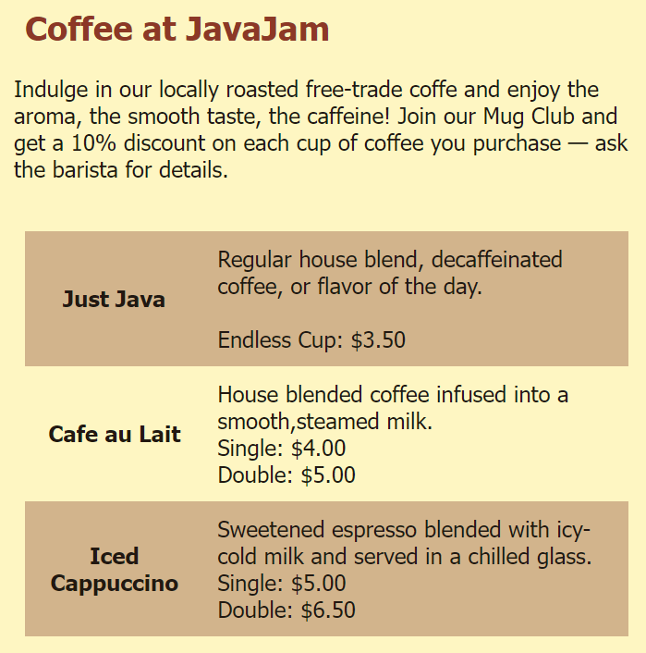
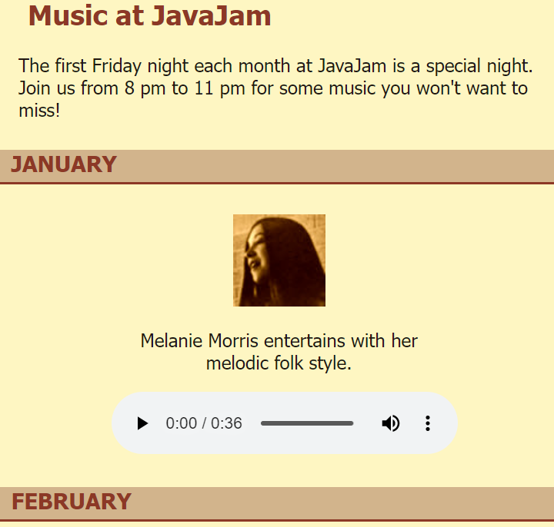
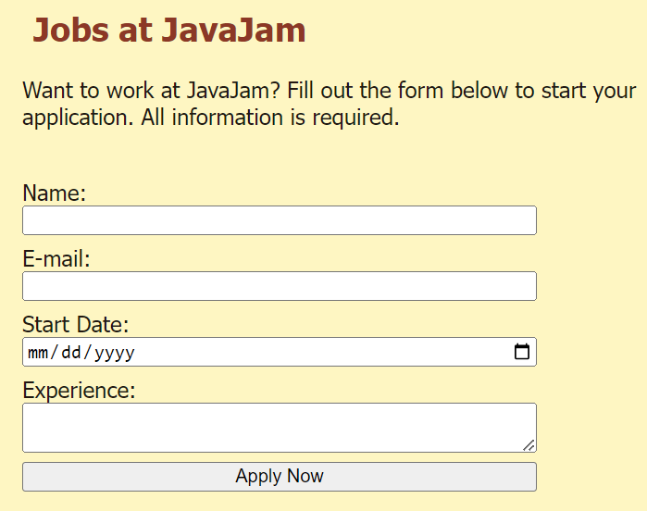
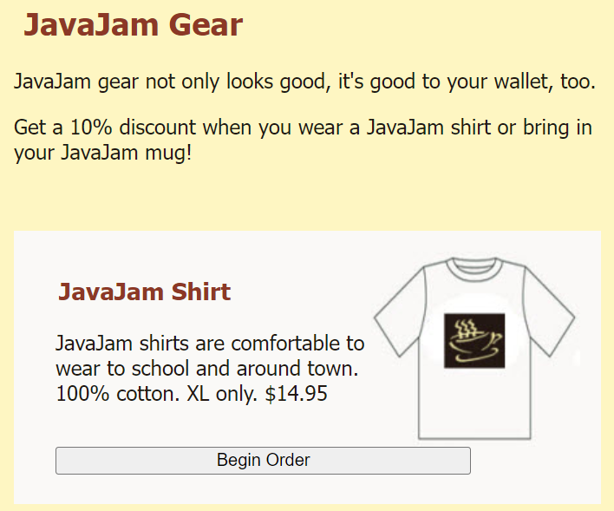
What is
JavaJam Coffee Bar?
Case study completed during Fall 2022 in ISA 345 with Professor Varin
A sample site for a small coffee shop business
Includes online menu, entertainment schedule, job application, and merchandise preview
Built using HTML, formatted with a cascading style sheet (CSS), and supported by JavaScript

Slide 4
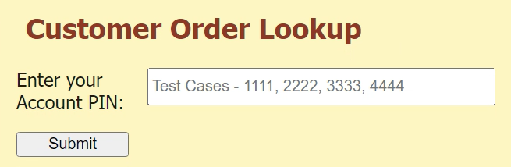
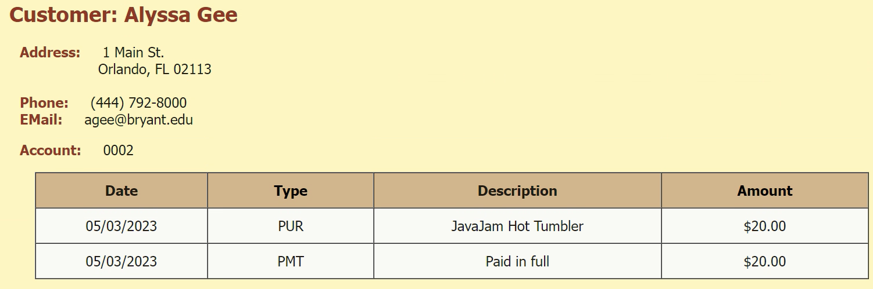
What is the
Account Balance Feature?

Slide 5
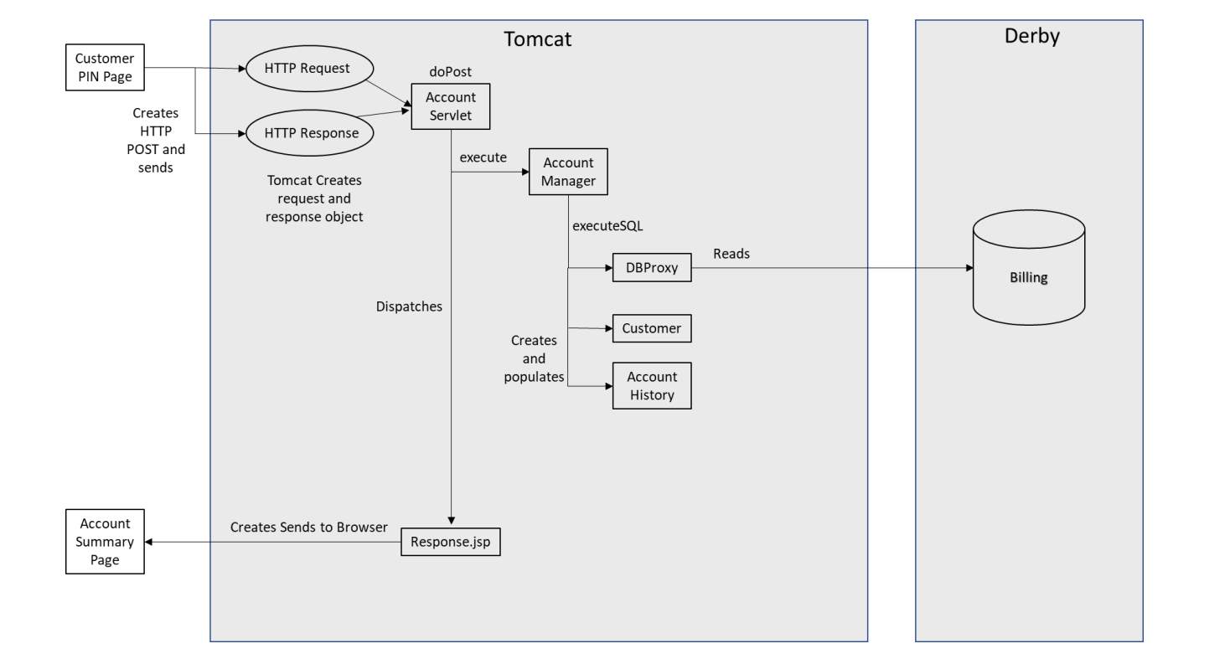
Module View Diagram
Notes:
Apache Tomcat provides a pure Java HTTP web server environment in which Java code can also run. Thus, it is a Java web application server. For the database, we used Apache Derby which is a relational database management system and is used for online transaction processing. Both Tomcat and Derby were local on VMWare.
Our web application uses a combination of HTML, Java, and SQL. The front-end and back-end are separate in the way that the HTML page can be swapped out with another HTML page, and the Java and DB will remain with the same functionality. This makes it suitable for businesses to use because they all practically have the same functionality, but different front-pages.
We use SQL statements to pull information from our Derby database. That is where all the customer and account information is stored.

Slide 6
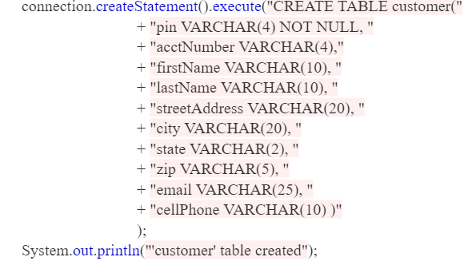
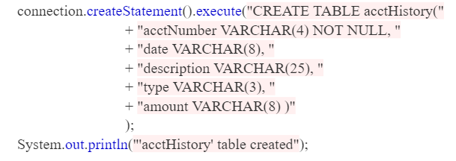
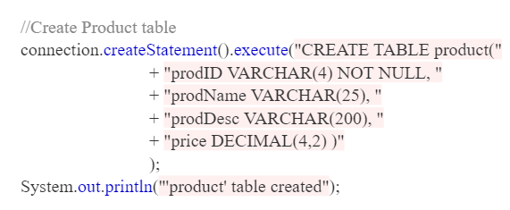
CreateDB.java

Slide 7
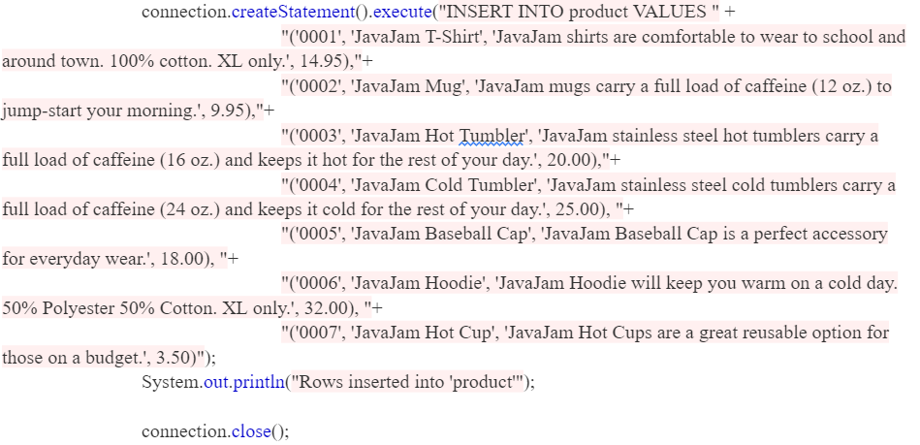
CreateDB.java

Slide 8
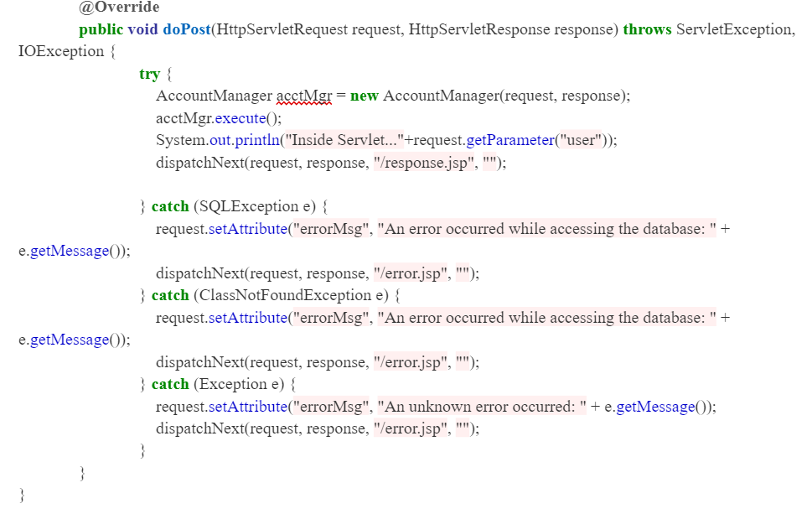
AccountServlet.java

Slide 9
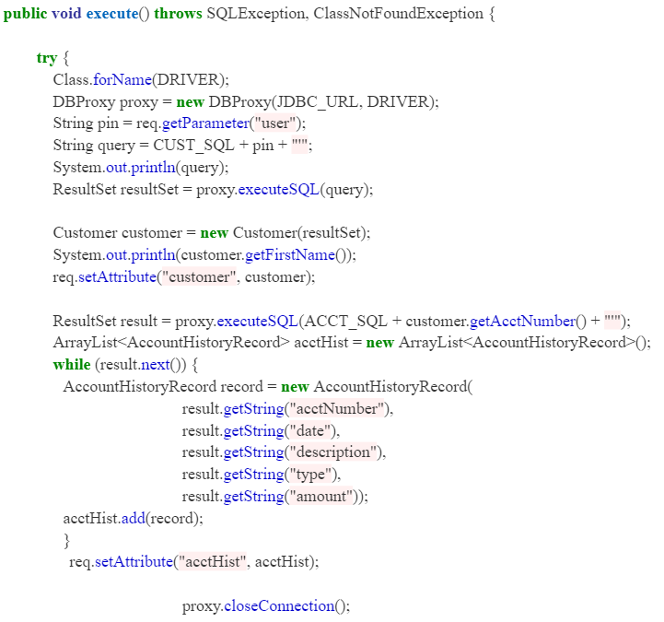
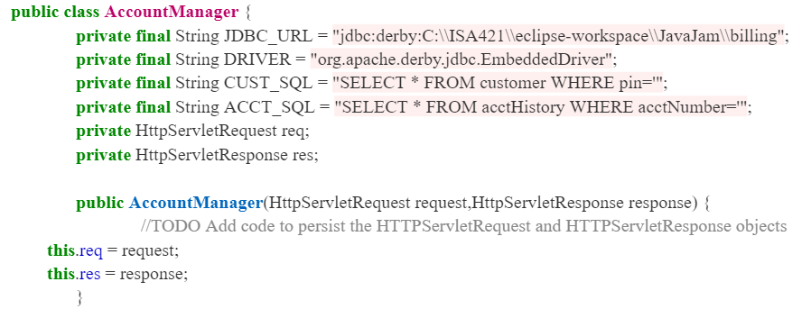
AccountManager.java

Slide 10
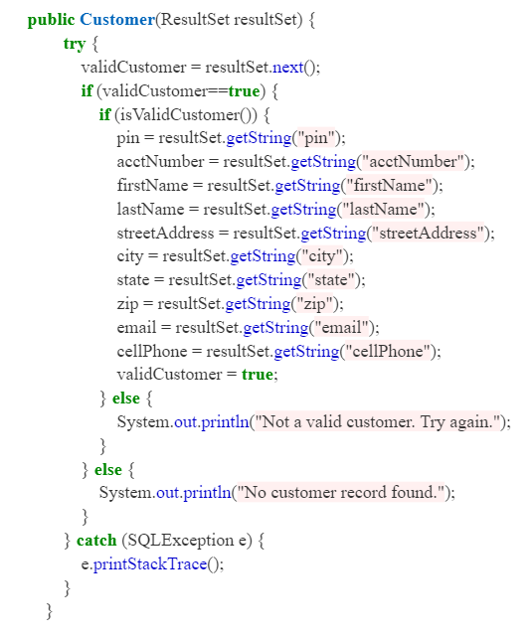
Customer.java
Notes:
Customer is wrapper class: In object-oriented programming, a wrapper class is a class that encapsulates types, so that those types can be used to create object instances and methods in another class that needs those types.
Constructs a Customer instance from a Result Set containing a customer record and
* sets the internal state to true or false for a valid customer. A valid customer is
* the case where there is a matching PIN in the database for the Customer. An invalid
* state is set when there was no Customer record in the Result Set.
*
* In the event of an SQLException, the internal state is set as invalid and the
* stack trace is displayed on the console.

Slide 11
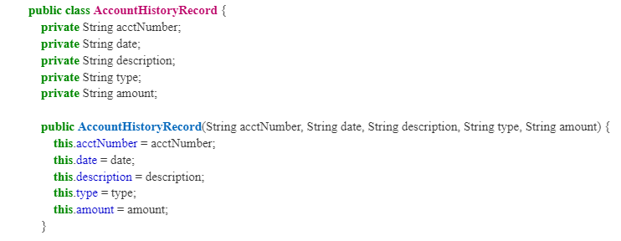
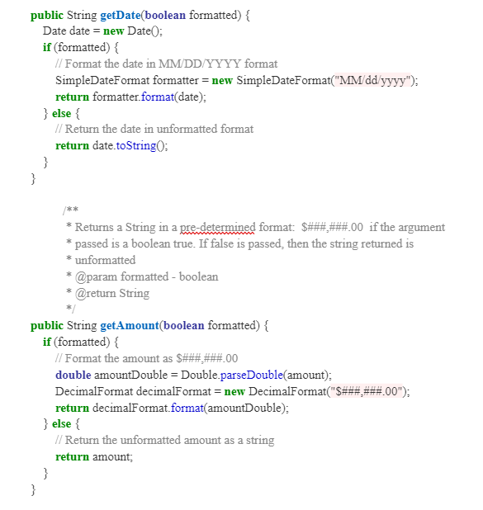
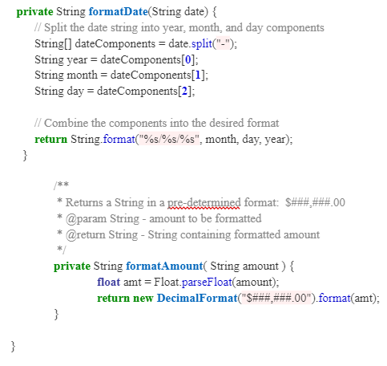
AccountHistoryRecord.java
Notes:
Account history is the payment and order history for accounts of the customer
Ex. if a customer placed a precious order for something like fuel and then there was a payment for that a date after that payment.
First you have the account History record
This guided us through the entire code
After variables, You see our constructors
its lists account number, date, description and so on which are just the fields that are associated with one line of the account history data
Getters/accessors
we provided so people cant change that data just access it (and as you can see we did that for each attribute thats part of the class)
For the get date and amount boolean formatt so it just stores true or false as possible values
Lastly for the private string which takes in string data (Returns a String in a pre-determined format that we had to create

Slide 12
JavaJam Web
Application Demo
Displays front-end functionality of the account balance round trip
Demonstrates the concepts of the cart and account creation pages

Slide 13
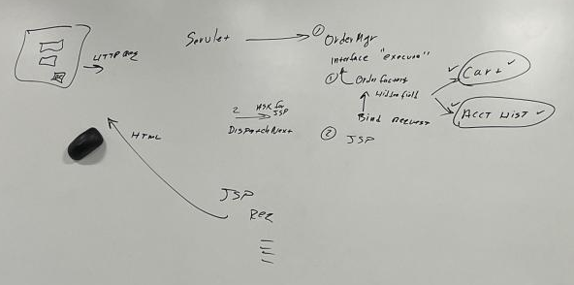
Unimplemented Module View Diagram for Cart
Notes:
Similar to the Account Balance, our cart would have the same roundtrip. We would use the same HTML page, which sends a HTTP request to the Servlet. The servlet would then invoke an execute method in OrderManager which would execute SQL statements to access the database. The database will contain a table for the cart and account history of course to track current and past orders. Once the database hands the information back over, a response jsp will be dispatched from the OrderManager. A page would appear with an itemized order.

Slide 14
Challenges Faced
Debugging Java classes
Struggled in using the debugging tool efficiently
Resolved after meeting with Professor Varin
Overconfidence in our Java knowledge
Assumed classes would be completely quickly
Required multiple meetings and dozens of emails with Professor Varin to complete
Took us until the last day to get a round trip
Wasted time and resources
Time used inefficiently early on in designing new web pages
Should have reallocated resources to Java classes sooner
Unable to achieve total functionality due to wasted time and time constraints

Slide 15
Lessons Learned
Time management & personal accountability
Should have tackled the project sooner rather than later (due to overconfidence)
Now know to start projects sooner to see if we run into any issues
The value of effective communication
Group chat for easy team contact
Constant updates on project status kept team up to date
If struggling, we knew to reach out and ask for help
Utilizing all available resources
Professor Varin was really helpful
The textbook
Videos our professor had posted

Slide 16
Questions or Comments?
Thank you for attending our presentation!
Alexander Bean, Zachary Cullison, Alyssa Gee, Veronica Wallace

